Slide 1


2021.03.26
汇报人：纪清玮

Slide 2
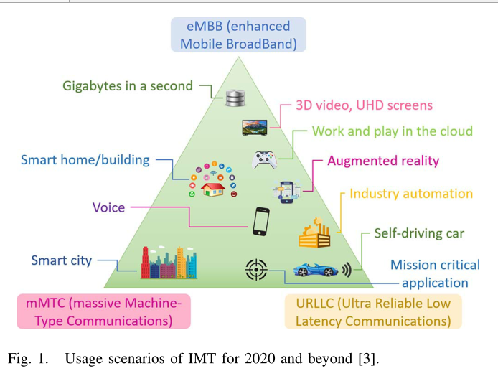
Three Principal Use Cases
eMBB：the human-centric use cases for access to multimedia content, services and data (e.g., 3D video, UHD screens )
URLLC：capabilities such as throughput, latency and availability
(e.g.industry automation, mission-critical applications,self-driving cars）
mMTC：a very large number of connected devices ，a relatively low volume of non-delay sensitive data
smart grid,(e.g.smart home/building, smart cities）

Slide 3
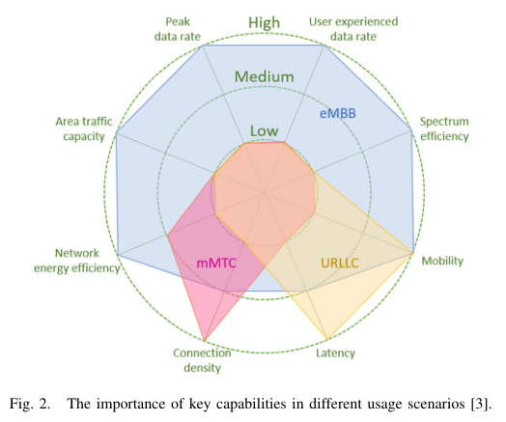
The Importance Of Key Capabilities
eMBB： user experienced data rate, area traffic capacity, peak data rate, mobility, energy efficiency and spectrum efficiency
URLLC：low latency , safety(in some high mobility cases)
mMTC：high connection density , low cost device with long operational lifetime

Slide 4
Test Environments
ITU-R.M.2412
Indoor Hotspot-eMBB: indoor isolation environment, stationary crowds, high user density.
Dense Urban-eMBB: urban , high user density and business traffic, pedestrians and vehicle users
Rural-eMBB: Rural, large coverage area, pedestrians, vehicles and high-speed vehicles.
Urban Macro-mMTC: urban macro , continuous coverage, connected machine type terminals.
Urban Macro-URLLC: Urban macro , ultra-reliable and low-latency communications.
3GPP
The twelve scenarios include indoor hotspot, dense urban, rural, urban macro, high-speed, extreme long-distance coverage in low-density areas, urban coverage for massive connections, high-way scenario, the urban grid for connected cars, commercial air to ground, light aircraft scenario, and satellite extension to terrestrial.

Slide 5
Example Analysis--High Speed
Will TCP work in mmWave 5G cellular networks?
Done：
analyzed TCP’s behavior over 5G mmWave networks in a high-speed train
investigated the impacts of different parameters on the most important KPIs of TCP
had a brief examination of TCP over 5G mmWave in the urban deployment and see how applicable it is
Not researched：
the analysis does not cover all possible situations that a UE can have inside a city

Slide 6
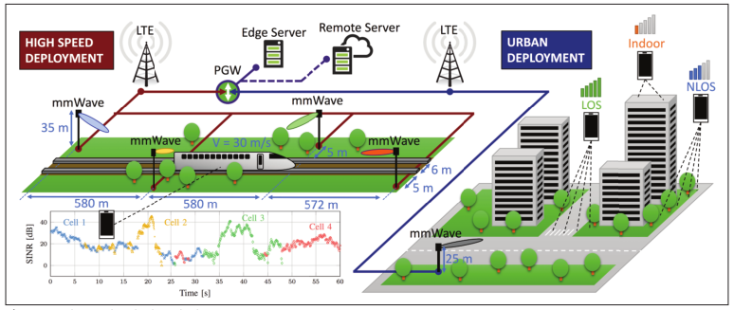
Example Analysis
two deployments of the TCP server ：
Traditional：server--remote data center，minimum RTT--40 ms(for the latencies of both the core network and the public internet)
MEC：server—close to the gNBs with smaller latency (of the order of 4 ms)

Slide 7
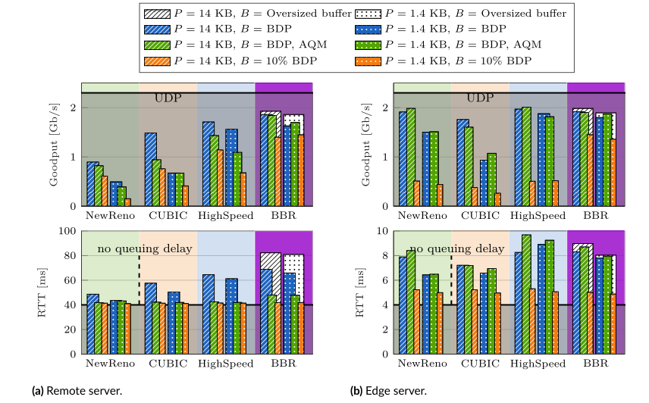
Impact of the server deployment
Fig：Goodput and RTT for the high speed train scenario, with the remote and the edge server for different combinations of the buffer size and the MSS.
Loss-based TCP benefits from the shorter control loop related to an edge server deployment
the RTT difference between the large and the small RLC buffer is lower in absolute terms

Slide 8
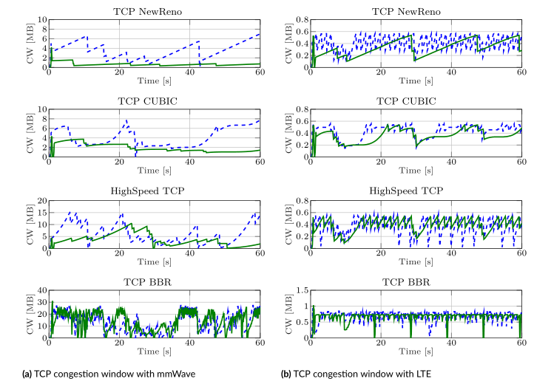
Impact of the congestion control algorithm
Fig：Congestion window evolution over time for different CC algorithms. The scenario is configured with remote servers and small RLC buffers
The congestion control algorithm has a stronger impact in the remote server scenario.
with small buffers, BBR produces the highest goodput (especially in the edge server scenario), with a latency comparable to loss-based TCP.

Slide 9

Result Analysis
TCP Performance Analysis on 5G mmWave Network：
Edge vs. Remote Server：shorter control loop，react faster to link impairments
Handover and Multi-Connectivity：maintain stable connections，avoid TCP timeouts
CC Algorithms：performance variations，servers，rate and latency（BBR is better）
TCP Packet Size：larger packet size，faster growth of cwnd，higher achievable rate
Link-level Solutions：retransmission，tradeoff between throughput and latency
RLC Buffer Size：erratic nature of mmWave channels，buffer overflow

Slide 10
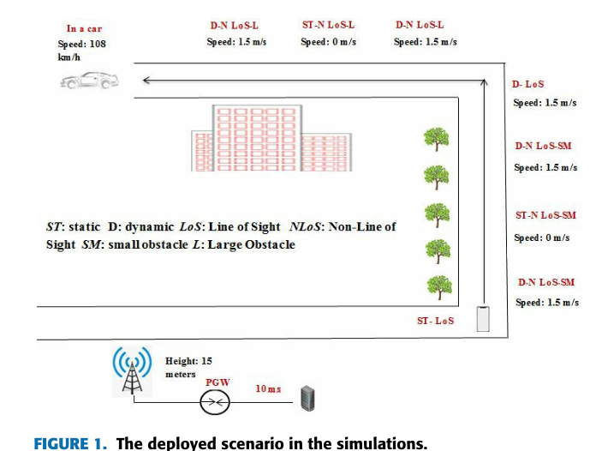
Example Analysis--Dense Urban
Open Trends on TCP Performance over Urban 5G mmWave Networks
Done：
TCP over 5G millimeter-wave in a city
the impact of different parameters including remote servers, RLC buffer size, CC, MSS
three important KPIs：throughput, RTT, and cwnd
Not researched：
Brief description of TCP behavior on edge server

Slide 11
Result Analysis
All studied TCPs can benefit from a larger RLC buffer size in terms of throughput at the cost of latency. Taking into account uses cases, eMBB can benefit from deploying a larger RLC buffer, but URLLC can benefit from deploying a smaller RLC buffer.
BBR can have stable performance throughout most of the circumstances. It can usually function close to the minimum latency so that it can be the right choice for the URLLC use case.
BBR can benefit from using smaller buffers in contrast to loss-based TCPs.
All studied TCPs suffer from a remote server deployment.
In order to fulfill all needs to some level, deploying HighSpeed TCP by increased MSS along with an edge server deployment can be an appropriate choice as it can perform adequately in all conditions.

Slide 12
My future plans
Need to consider:
Deploy dense city scenarios
Use throughput, RTT, and cwnd as key performance indicators
Use TCP NewReno、High Speed TCP、TCP CUBIC and TCP BBR
Consider remote and edge servers at base stations or data centers
Current problem:
the use of ns-3 and the simulation of the above scenario

Slide 13
Thanks
汇报人：纪清玮

